Slide 1
CQRS & ES with the Axon 3 Framework
Lee Newfeld, Sept 2017

Slide 2
Introduction
What’s my aim?
CQRS and ES Primer
Dive in, using a familiar scenario…
Demos

Slide 3
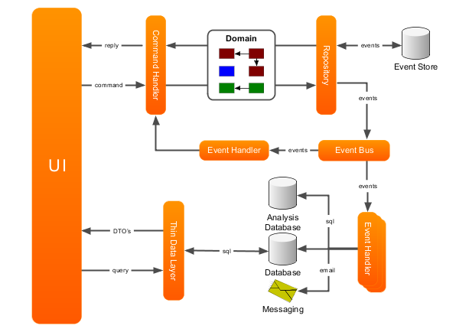
CQRS and ES Primer
Command/Query Responsibility Segregation
Components that change state are decoupled from components that read it
Event Sourcing
Every state change during an entities lifecycle is stored
The “current state” of an entity is the result of applying all events, in order, since the start of it’s lifecycle

Slide 4
A Familiar Scenario
Estate
Shop #1
Shop #n
Kiosk #1
Kiosk #n
Kiosk #1
Kiosk #n
Counter
Counter
Estate:
Many Shops
Containing a “Counter” and many “Kiosks”
Kiosk: Deposit Cash, Build a Slip
Counter: View Remotely, Send Commands to a Kiosk
Extensible… add more Shops

Slide 5
Aggregates & Repository
Aggregates
Encapsulate business logic
Responsible for guarding their own invariants
Repository
Responsible for providing access to aggregates.
Optimized for lookup by its unique identifier
@Aggregate
class Executive {
@AggregateIdentifier
kioskId: String
}
@AggregateMember
class Account {
balance: int
}
@AggregateMember
class PotentialSlip {
selections: List<PotentialSelection>
}
class PotentialSelection {
@EntityId
selectionId: String
name: String
numerator: int
denominator: int
stake: int
}

Slide 6
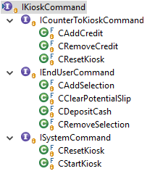
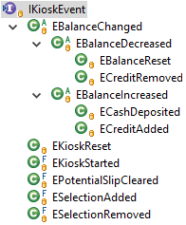
Commands & Events
Messages in the form of serialisable POJOs (to allow “location transparency”)
C<present_tense_verb><noun>
E<noun><past_tense_verb>
class CDepositCash {
@TargetAggregateIdentifier
kioskId: String
amount: int
}
class ECashDeposited {
kioskId: String
balance: int
amount: int
}

Slide 7
Command and Event Handlers
Axon routes commands (via the CommandBus) to exactly one Command Handler
@CommandHandler annotated methods (on the Aggregate, AggregateMember, or elsewhere if registered)
Executed within a Transaction (Unit of Work)
Publish Events when all is well
Axon routes Events (via the EventBus) to many Event Handlers
@EventSourcingHandler take priority – alter state
Then the @EventHandler methods…
@Aggregate
class Executive {
@AggregateIdentifier
kioskId: String
@CommandHandler
void handle(CResetKiosk cmd) {
// Validation and action...
// Publish events...
AggregateLifecycle.apply(
new EKioskReset(
cmd.getKioskId(), cmd.getReason()
));
}
@EventSourcingHandler
void on(EKioskReset event) {
// Alter state
...
}
}
}

Slide 8
Testing
Axon provides testing support via the AggregateTestFixture
Given…When…Then

Slide 9
Demo

Slide 10
Kiosk EventStore
jdbc:h2:mem:db;MODE=Oracle;DB_CLOSE_ON_EXIT=FALSE
SELECT
E.TIME_STAMP
, E.TYPE AS AggregateType
, E.AGGREGATE_IDENTIFIER AS AggregateId
, RIGHT(E.PAYLOAD_TYPE, LENGTH(E.PAYLOAD_TYPE)-11) AS EventName
, UTF8TOSTRING(E.PAYLOAD) AS Payload
FROM DOMAIN_EVENT_ENTRY E
ORDER BY
E.TYPE
, E.AGGREGATE_IDENTIFIER
, E.SEQUENCE_NUMBER

Slide 11
Distributing the Buses
SHOP “000001”
When a Kiosk starts up…
K1-1

Slide 12
Distributing the Buses
SHOP “000001”
It creates an Exchange and a Queue for receiving commands. They are bound together with a “routing key”
CMD-1
direct
“1-1”
K1-1
K1-1

Slide 13
Distributing the Buses
SHOP “000001”
CMD-1
direct
“1-1”
K1-1
K1-1
Additionally, it creates a second Exchange which it emits Events to
EVT-1
fanout

Slide 14
Distributing the Buses
SHOP “000001”
CMD-1
direct
“1-1”
“1-2”
K1-1
K1-2
Subsequent Kiosks (in the same Shop) bind to the same Exchanges in a similar way
K1-1
K1-2
EVT-1
fanout

Slide 15
Distributing the Buses
SHOP “000001”
CMD-1
direct
“1-1”
“1-2”
When the Counter comes up…
K1-1
K1-2
COUNTER
K1-1
K1-2
EVT-1
fanout

Slide 16
Distributing the Buses
It binds to the Command Queue. It can send a Command to a specific Kiosks by providing the corresponding Routing Key
SHOP “000001”
CMD-1
direct
“1-1”
“1-2”
K1-1
K1-2
COUNTER
K1-1
K1-2
EVT-1
fanout

Slide 17
Distributing the Buses
SHOP “000001”
CMD-1
direct
“1-1”
“1-2”
K1-1
K1-2
COUNTER
K1-1
K1-2
It also creates a Queue, bound to the Event Exchange, in order to receive Events from all Kiosks in the Shop
EVT-1
C1
fanout

Slide 18
Distributing the Buses
Commands can come into the Shop from external sources…
From Command Source
SHOP “000001”
CMD-1
direct
“1-1”
“1-2”
K1-1
K1-2
COUNTER
K1-1
K1-2
EVT-1
C1
fanout
…and external subscribers can handle Shop Events.
To other Subscribers…

Slide 19
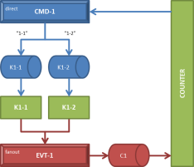
Distributing the Buses
ESTATE
RGN-1
RGN-2
RGN-1
RGN-2
ESTATE

Slide 20
Other Capabilities (in Brief)
Sagas
Extensibility (Command Bus, Event Bus, etc)
Replaying Events
Snapshots & Caching
Upcasting

Slide 21
Further Reading (or Watching)
Description | URL
Axon 3 Framework | http://www.axonframework.org/
CQRS | https://martinfowler.com/bliki/CQRS.html
Event Sourcing | https://martinfowler.com/eaaDev/EventSourcing.html
Bootiful CQRS with Axon | https://www.youtube.com/watch?v=Jp-rW-XOYzA&t=900s
Getting started with Axon 3 | https://www.youtube.com/watch?v=s2zH7BsqtAk https://www.youtube.com/watch?v=Fj365BufWNU https://www.youtube.com/watch?v=qqk2Df_0Pm8
Demo Source | https://github.com/sparcs360/axon-demo

